Slide 1

Exploratory Data Analysis
G2M insight for Cab Investment firm
September 21st 2023

Slide 2

Agenda
Executive Summary
Problem Statement
Approach
EDA
EDA Summary
Recommendations

Slide 3
Executive Summary
XYZ is a private firm in US. Due to remarkable growth in the Cab Industry in last few years and multiple key players in the market, it is planning for an investment in Cab industry and as per their Go-to-Market(G2M) strategy they want to understand the market before taking final decision.
XYZ

Slide 4





Problem Solving
Profit Analysis
City Comparison
Gender
Age
Year over Year Δ*
* Δ is the symbol for Delta; meaning of change

Slide 5


Approach
Features: 19 Features (including 9 derived features)
Timeframe: 2016 – 2018
Total Datapoints in master_df: 359,392
Assumptions:
Profits are calculated by subtracting Cost from the Price.
Outliers found present in Price, but with no additional information of trip duration, it wont be treated as such.
Users is accounted for the number of cab users in the city, assuming it can be other cab users (including Company)
Cab_Data.csv
Customer_ID.csv
master_df
City.csv
Transaction_ID.csv

Slide 6
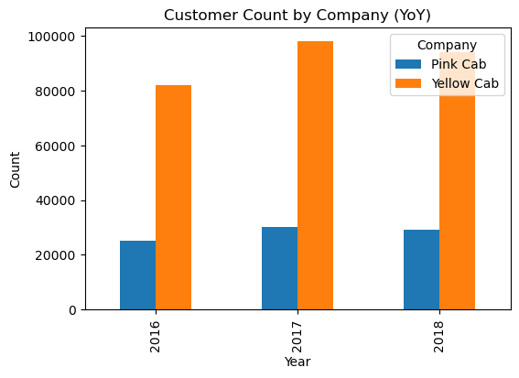
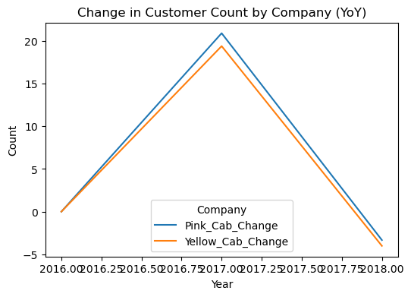
Customer Count by Company Δ YoY
Year | Pink Cab | Yellow Cab | Pink_Cab_Change | Yellow_Cab_Change
2016 | 25080 | 82239 | 0.00 | 0.00
2017 | 30321 | 98189 | 20.90 | 19.39
2018 | 29310 | 94253 | -3.33 | -4.01

Slide 7
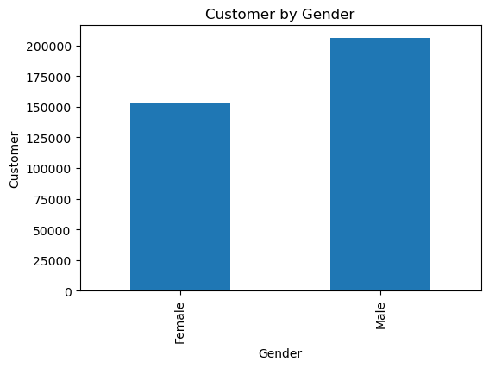
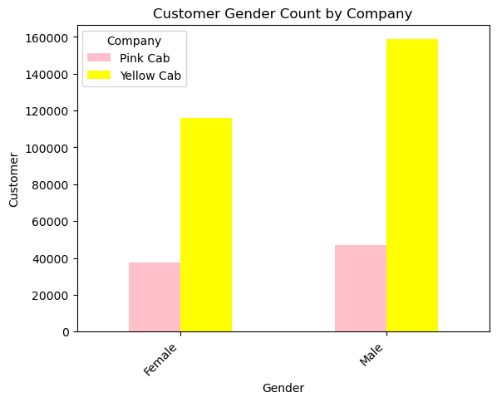
Customer by Gender
Gender | Pink Cab | Yellow Cab | Total Count | Change | Difference
Female | 37480 | 116000 | 153480 | 67.69 | 42.71
Male | 47231 | 158681 | 205912 | 70.24 | 57.29

Slide 8
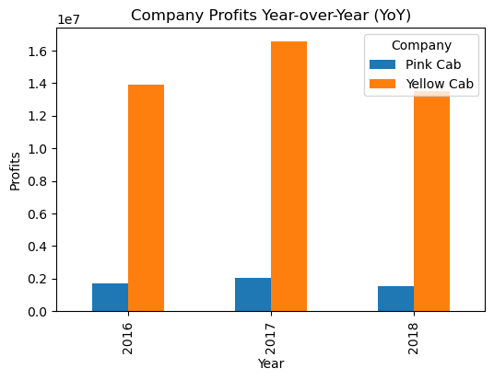
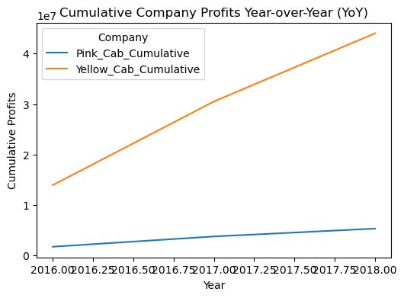
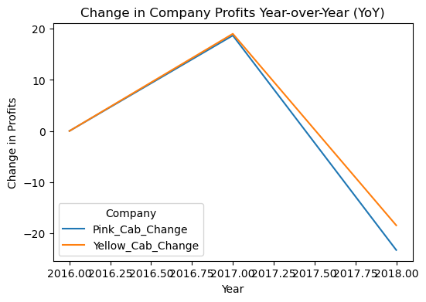
Profit Analysis
Year | Pink Cab | Yellow Cab | Pink_Cab_Change | Yellow_Cab_Change | Pink_Cab_Cumulative | Yellow_Cab_Cumulative | Pink_Cumulative_Change | Yellow_Cumulative_Change
2016 | 1713511.24 | 13926996.40 | 0.00 | 0.00 | 1713511.24 | 13926996.40 | 0.00 | 0.00
2017 | 2033655.03 | 16575977.40 | 18.68 | 19.02 | 3747166.27 | 30502973.80 | 118.68 | 119.02
2018 | 1560161.92 | 13517398.79 | -23.28 | -18.45 | 5307328.19 | 44020372.59 | 41.64 | 44.32

Slide 9
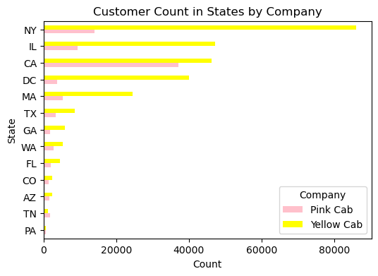
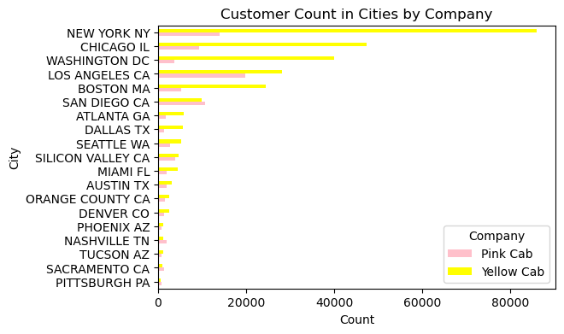
City and State Customer Count

Slide 10
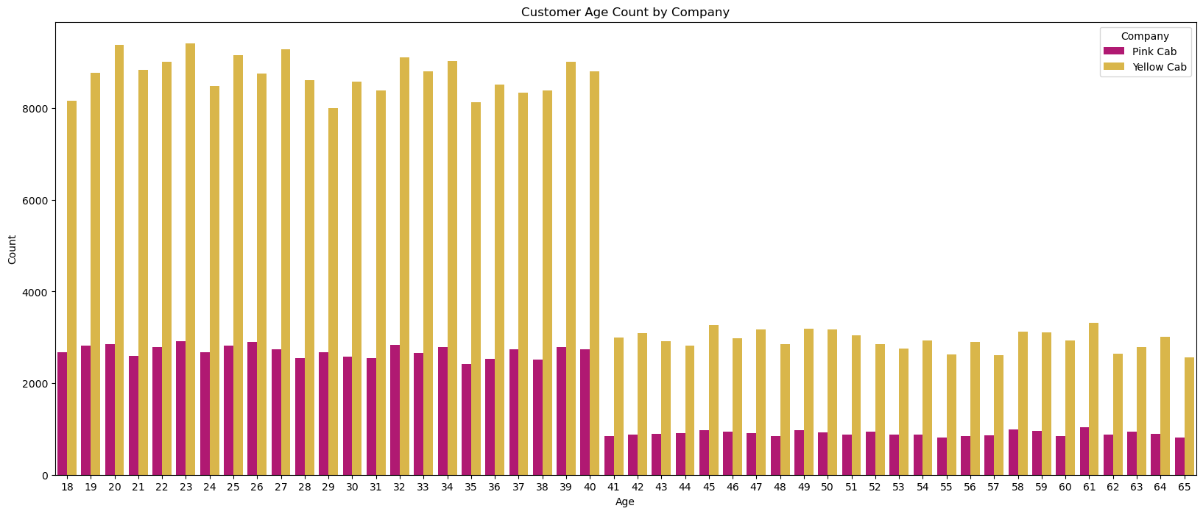
Customer Age

Slide 11
Recommendation

Slide 13
Thank You

